Slide 1
Data Hiding - Minimization - Simplicity
GenCyber Girls in CybHER Security
Middle School Girls Camp at DSU

Slide 2
Data Hiding
Data hiding is any attempt to prevent people from able to see data.
Activities:
Digital Scavenger Hunt
Students given iPads and clues of locations across campus
Students find locations and take group selfies
Teams race back and extract EXIF data from images
Teams make a digital map of their locations with EXIF data (dates of stops, mapped to location)

Slide 3
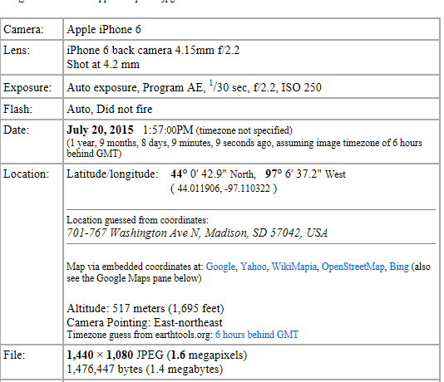
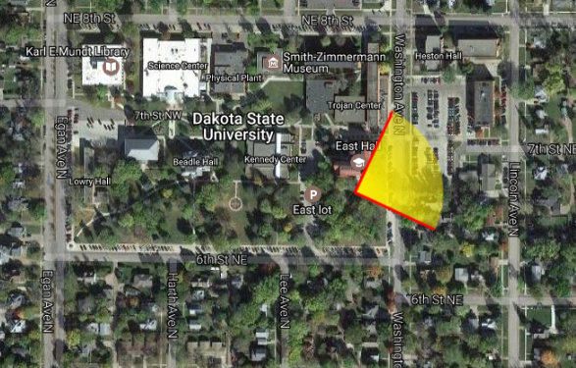
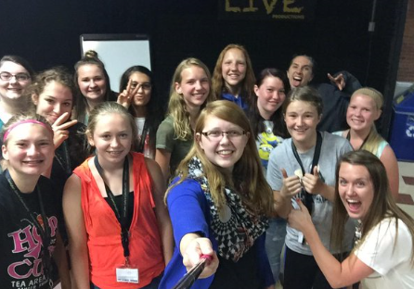

Slide 4
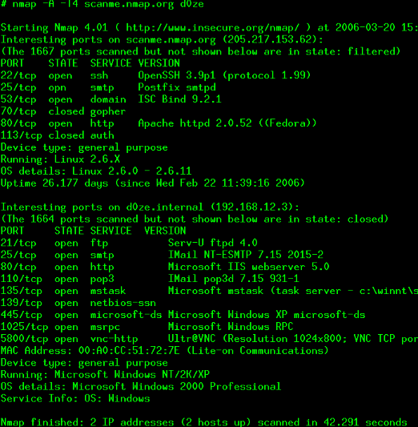
Minimization
1. Port Scanning
Students learn how to scan a system for
open ports and then how to close them

Slide 5
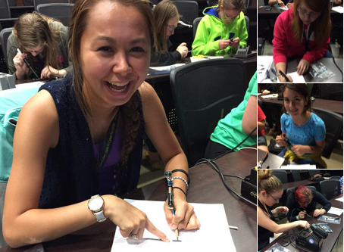
Simplicity
The less complicated something is, the less likely it is to have problems. It is also easier to troubleshoot and fix. Keep it simple!
Activities
1. Soldering: In this activity campers are taught how to solder. A small kit is used to create a cool electronic toy that races around, lights up, or makes noise. The girls learn about what soldering is, how it works, and how the circuit boards that make up all of our devices are put together.

Slide 6
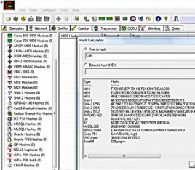
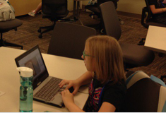
Simplicity
Password Cracking
Creating strong passwords doesn't have be super complicated. We have students crack passwords from a known hash list, including their own, then have them compile new passwords and see how long they take to crack
Students learn that gCGc2016iTBCa! is a great way to learn about secure password

Slide 7
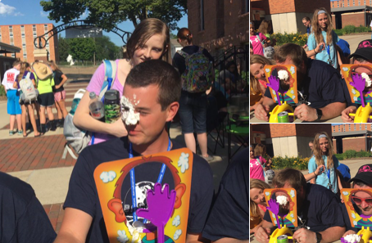
Putting it all together- Pie Face Competition!

Slide 8
Internet of Strings Version 2.0
InternetOfStrings.xyz

Slide 9
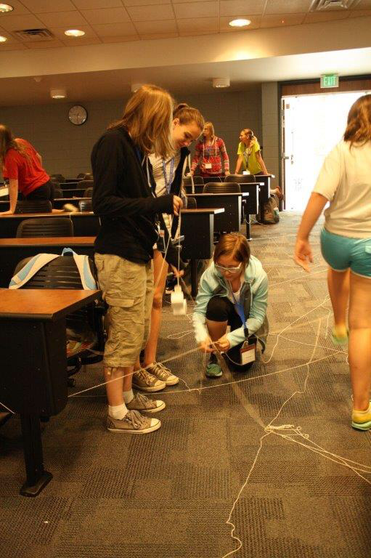
Objective
Lots of chaos
How routers routers + firewalls work
Toss in some security principles

Slide 11
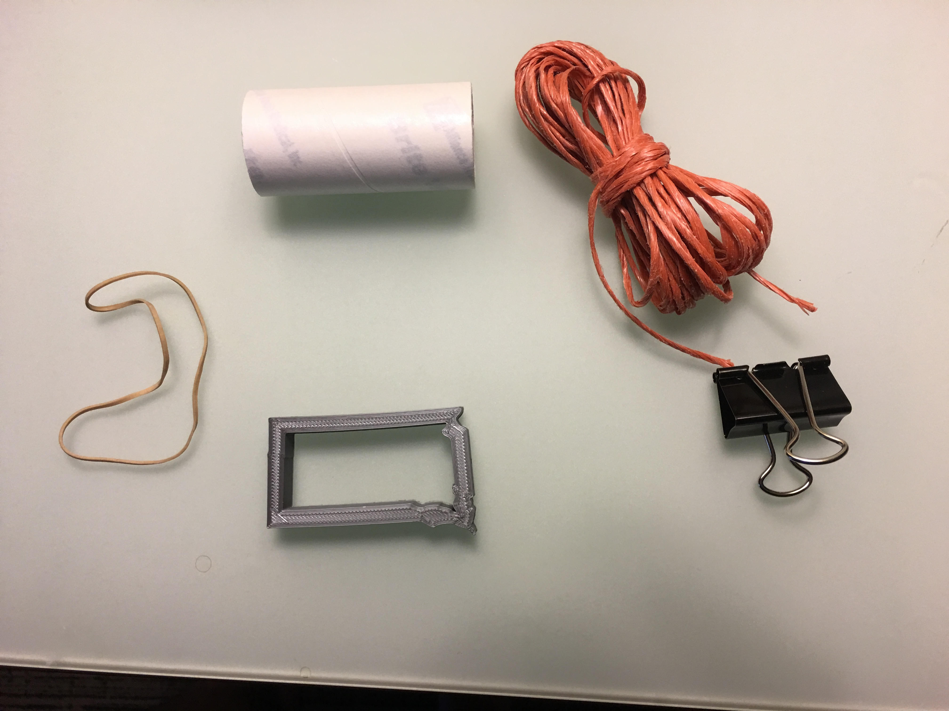
Required Equipment
Lots of string
Links on the internet
Shapes (we 3D printed ours)
Represents a port
Colored binder clips
SYN/ACK/RST
Film canister
Encapsulated data
Rubber band

Slide 12
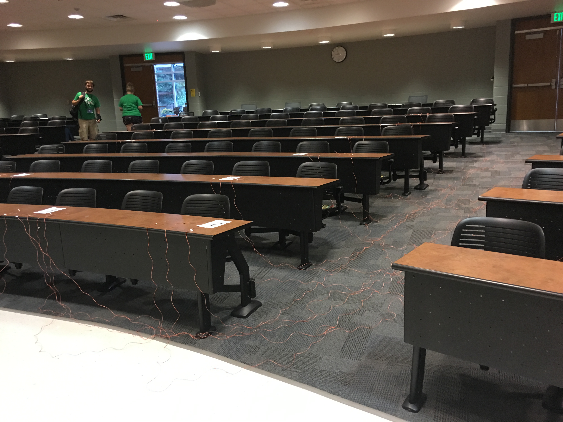

Slide 13
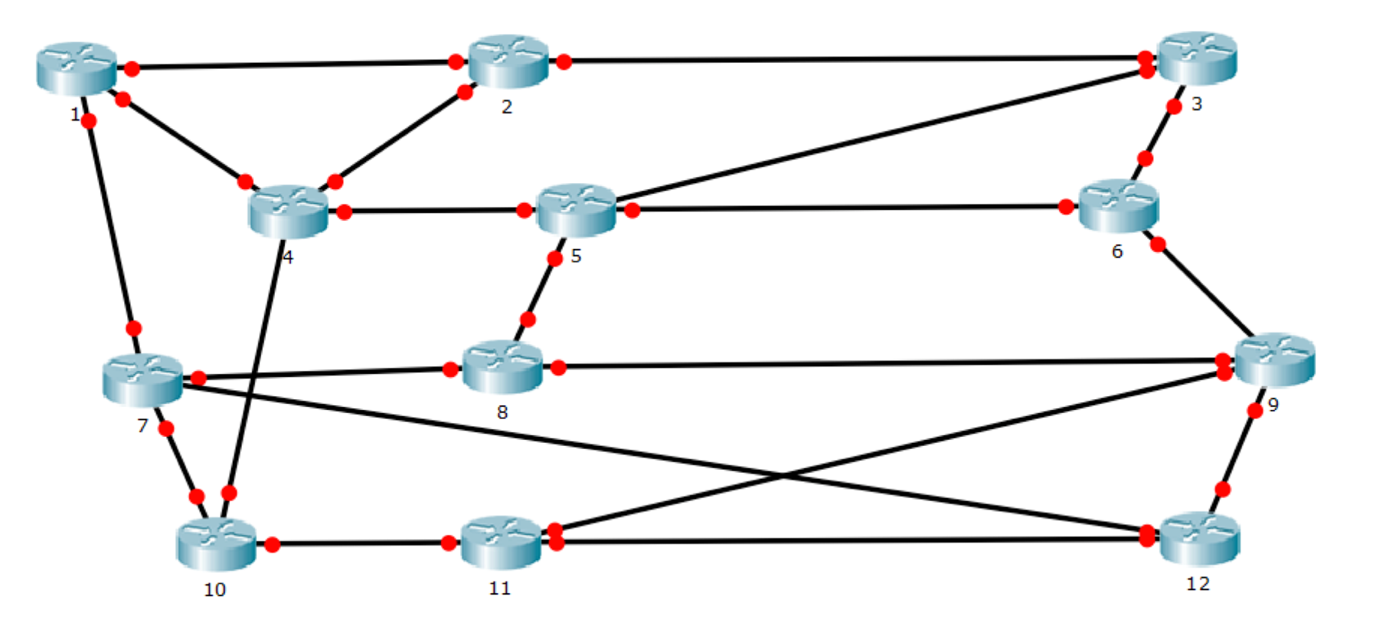

Slide 14
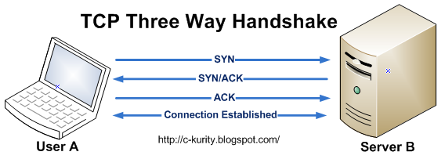

Slide 15
SYN
Shape on string
Route
Packet routed across strings Shape arrives at destination
Check ACL
Does the shape fit? Assuming yes...
SYN/ACK
Destination replies with green binder clip
Send Data!
Packet with canister

Slide 16
SYN
Shape on string
Route
Packet routed across strings Shape arrives at destination
Check ACL
Does the shape fit? Assuming yes...
RST
Destination replies with red binder clip
Try again
Resend SYN with a different shape

Slide 17
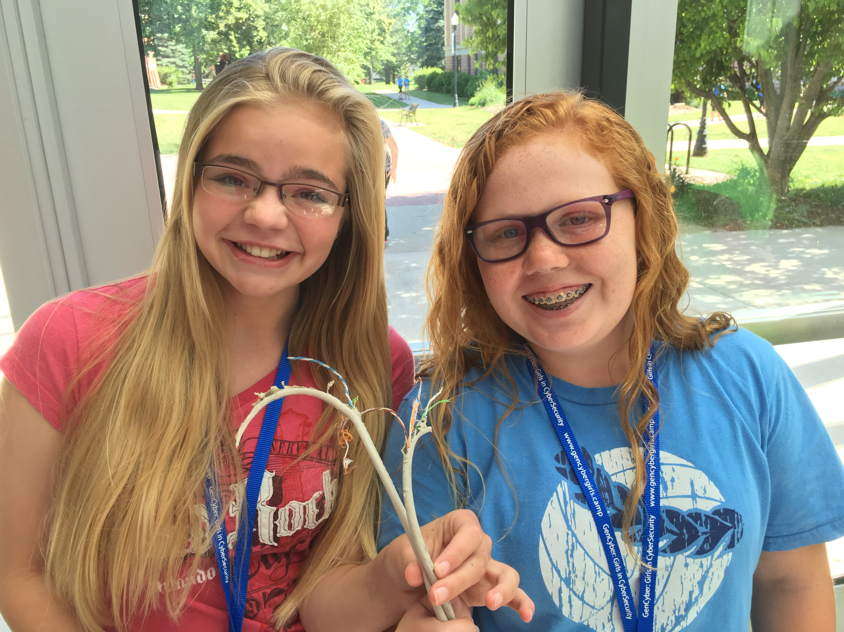
What Goes Wrong
Links "go offline"
An overwhelmed router?
Tampering
Collisions

Slide 18
Security Principles
Encapsulation (candy contained in the packet)
Modularity (add, remove, re-converge firewalls on internet)
Abstraction (simulating how the internet works, offline)
Layering (decisions made at different levels)

