Slide 1
Internet of Strings Version 2.0
InternetOfStrings.xyz

Slide 2
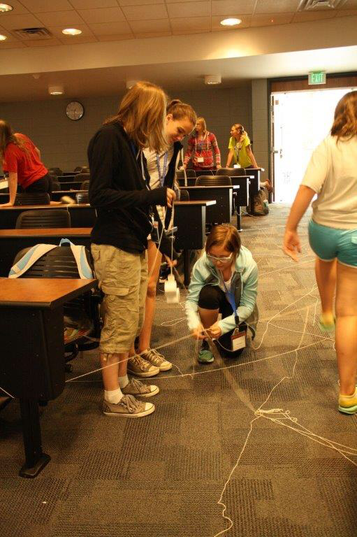
Objective
Lots of chaos
How routers routers + firewalls work
Toss in some security principles

Slide 4
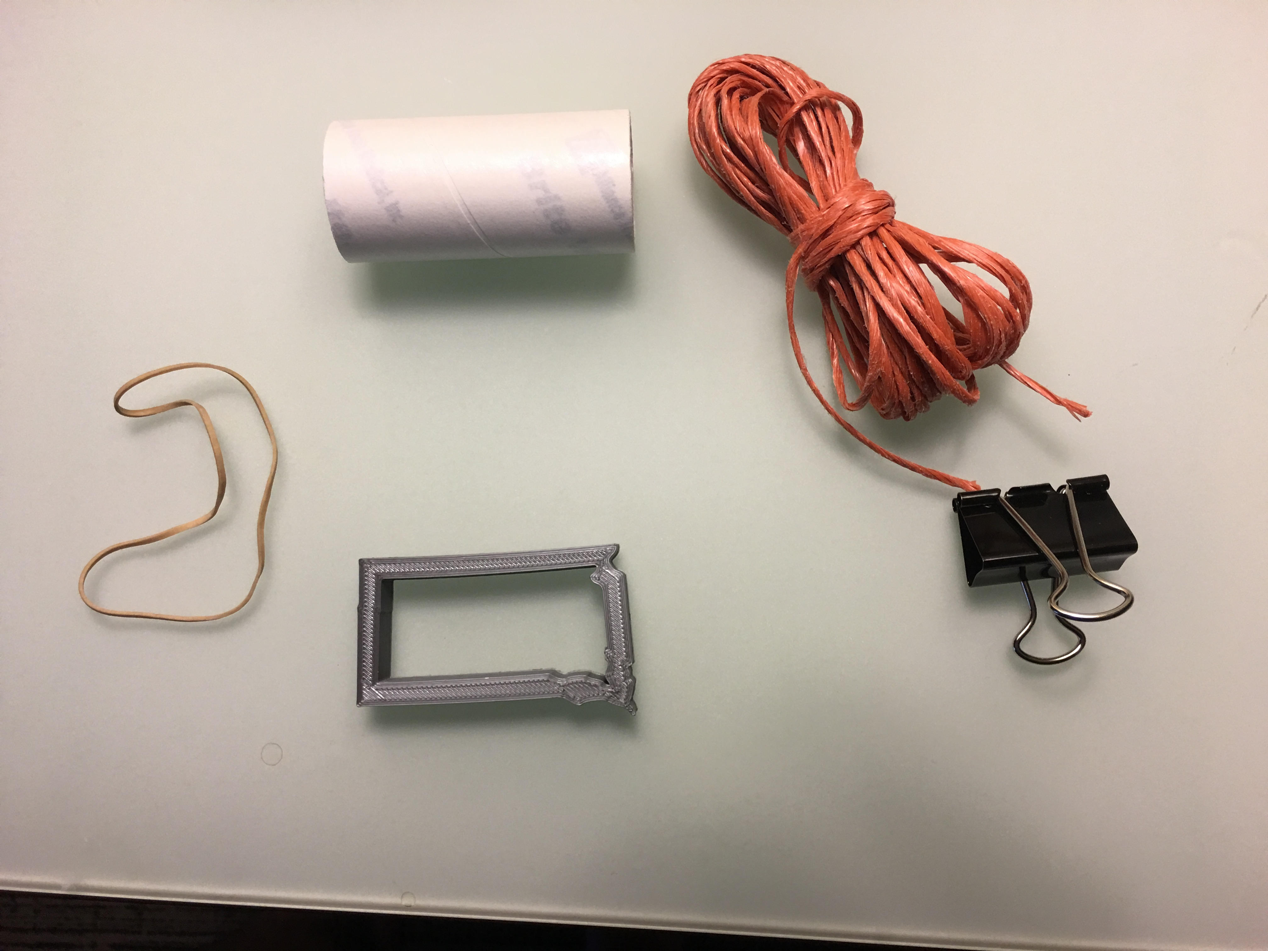
Required Equipment
Lots of string
Links on the internet
Shapes (we 3D printed ours)
Represents a port
Colored binder clips
SYN/ACK/RST
Film canister
Encapsulated data
Rubber band

Slide 5
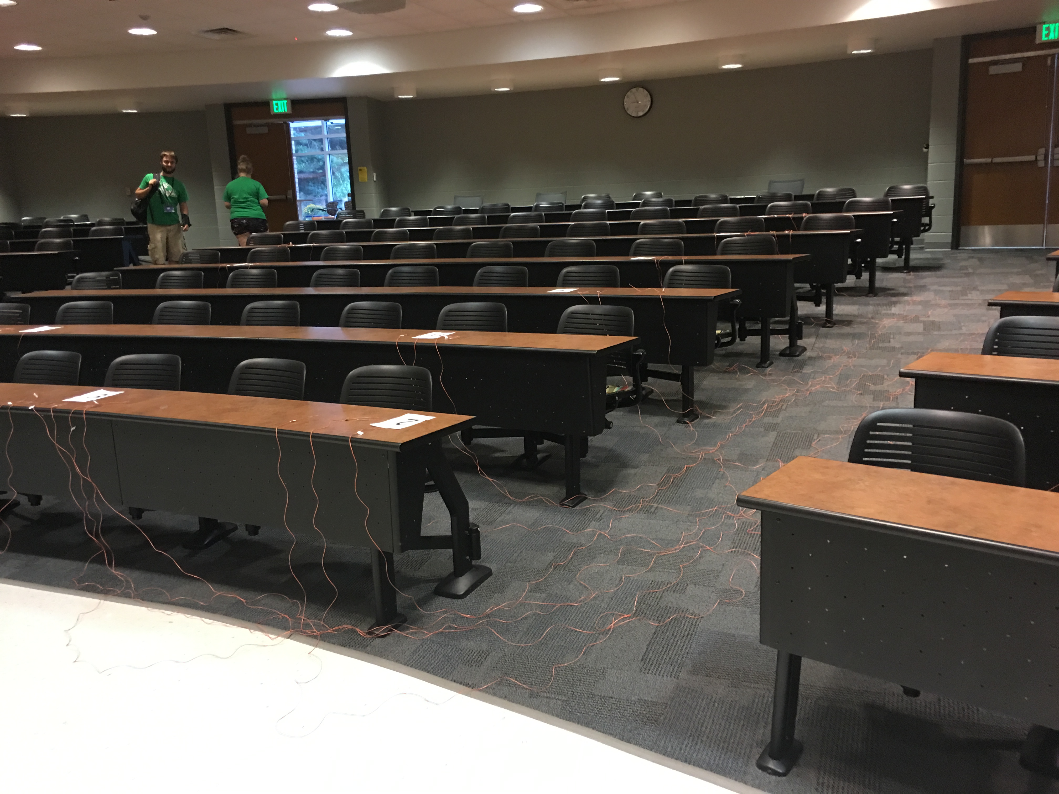

Slide 6
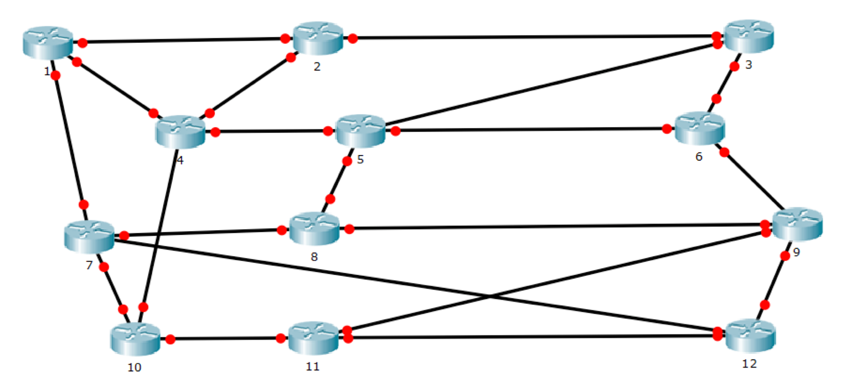

Slide 7
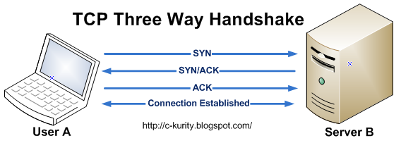

Slide 8
SYN
Shape on string
Route
Packet routed across strings Shape arrives at destination
Check ACL
Does the shape fit? Assuming yes...
SYN/ACK
Destination replies with green binder clip
Send Data!
Packet with canister

Slide 9
SYN
Shape on string
Route
Packet routed across strings Shape arrives at destination
Check ACL
Does the shape fit? Assuming yes...
RST
Destination replies with red binder clip
Try again
Resend SYN with a different shape

Slide 10
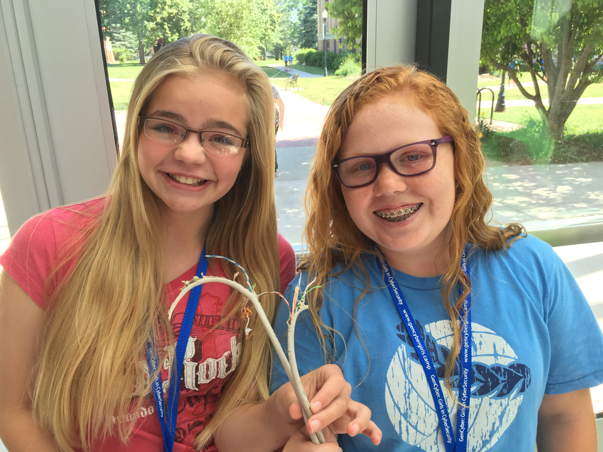
What Goes Wrong
Links "go offline"
An overwhelmed router?
Tampering
Collisions

Slide 11
Security Principles
Encapsulation (candy contained in the packet)
Modularity (add, remove, re-converge firewalls on internet)
Abstraction (simulating how the internet works, offline)
Layering (decisions made at different levels)

